Slide 1
Hospitalization Cancellation
Gaurav Kumar

Slide 2
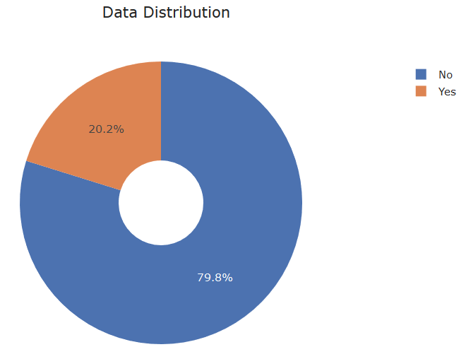
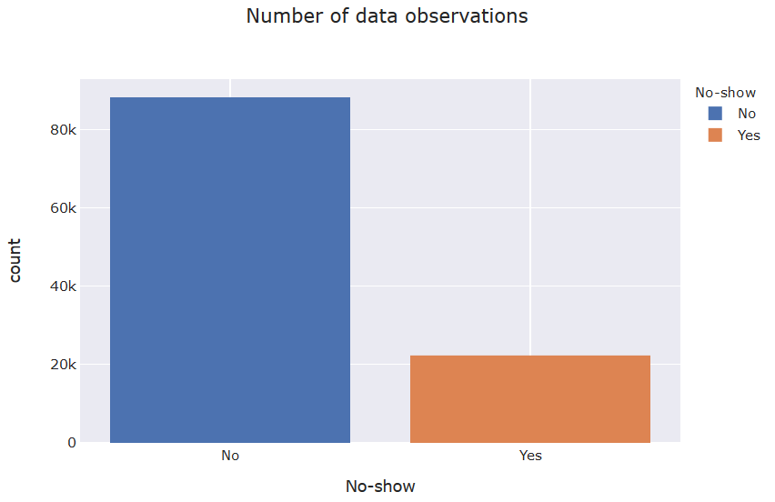
Hospitalization Cancellation
Data Distribution
No: Appointment Not Cancelled
Yes: Appointment Cancelled

Slide 3
Hospitalization Cancellation
Influencing Factors considered
Gender
Scheduled Day
Appointment Day
Age
Neighbourhood
Scholarship
Hipertension
Diabetes
Alcoholism
Handicap
SMS_received
Gap b/w Scheduled day and Appointment Day
Number of times Patient has registered in the hospital in past
Patient historical Cancellation information / proportion
Day of Month
Day of Week
Derived

Slide 4
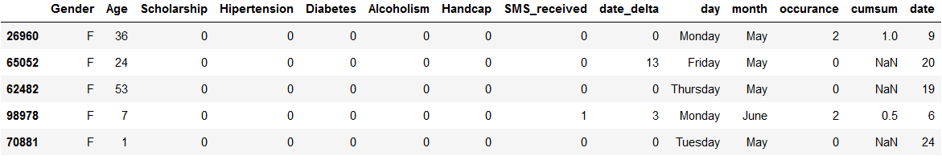
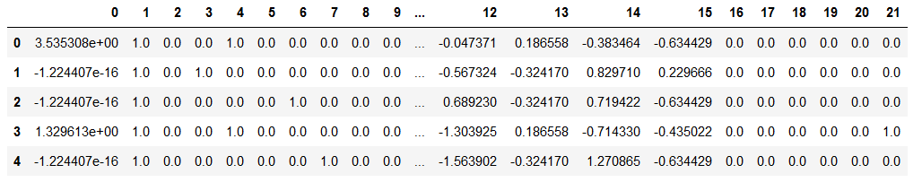
Hospitalization Cancellation
Data
Data for Analytics
Data for ML Model [Converted]

Slide 5
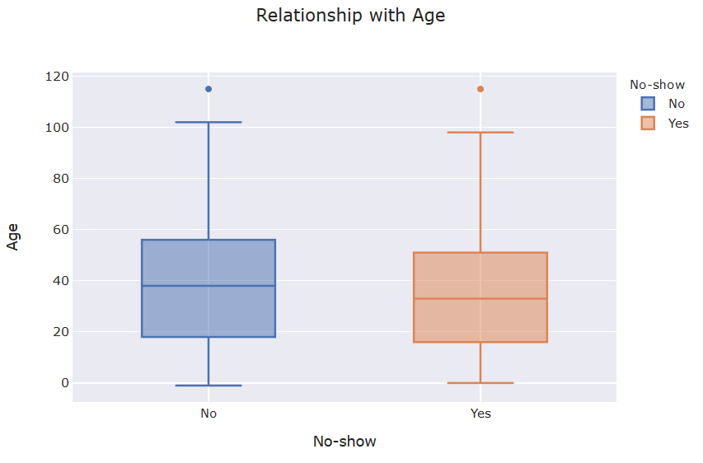
Hospitalization Cancellation
Correlation b/w [Age and Cancellation status]
No Apparent Correlation between Age and cancellation status

Slide 6
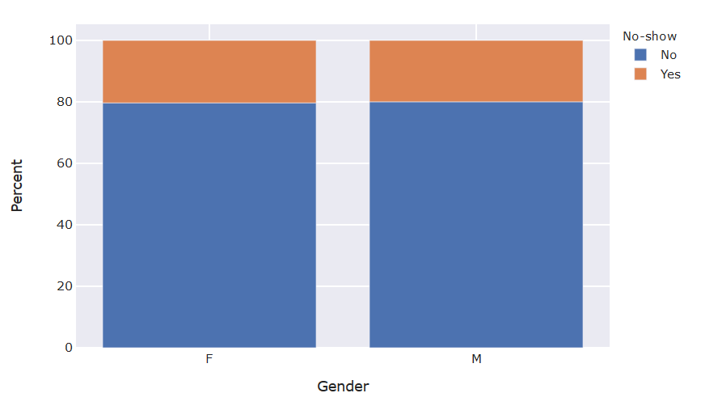
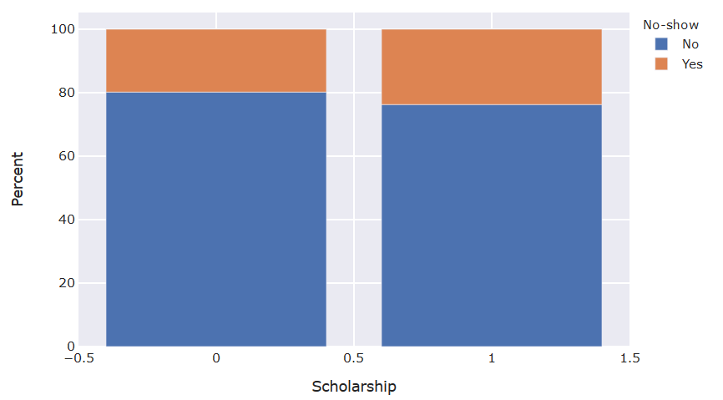
Hospitalization Cancellation
Correlation b/w [Gender/scholarship and Cancellation status]
No Apparent Correlation between Gender and cancellation status
Slightly Higher Cancellation with higher scholarship

Slide 7
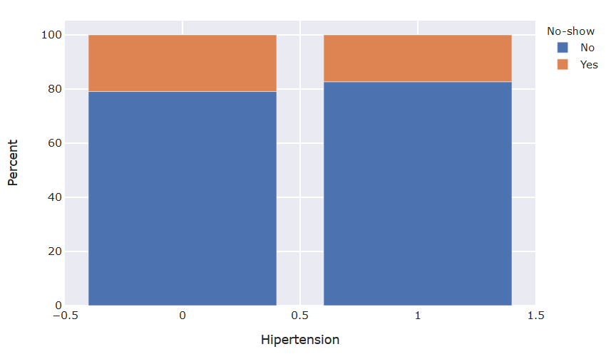
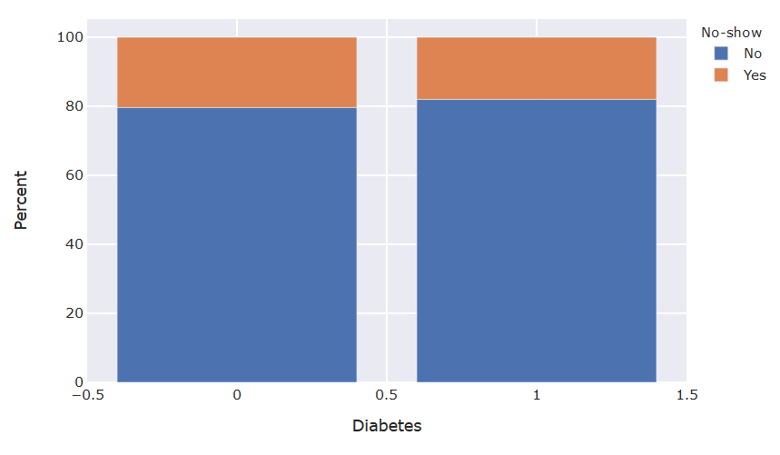
Hospitalization Cancellation
Correlation b/w [Hipertension/Diabetes and Cancellation status]
Slightly Higher Cancellation with higher Hipertension and higher Diabetes

Slide 8
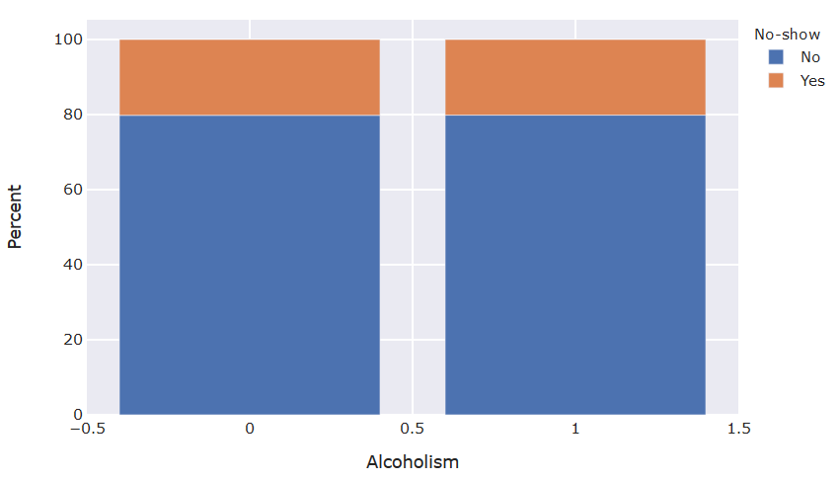
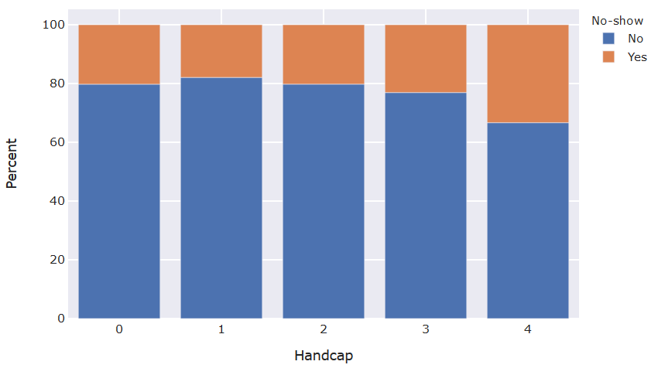
Hospitalization Cancellation
Correlation b/w [Alcoholism/Handicap and Cancellation status]
No Apparent influence of Alcoholism
Higher Cancellation chances with High level of handicap

Slide 9
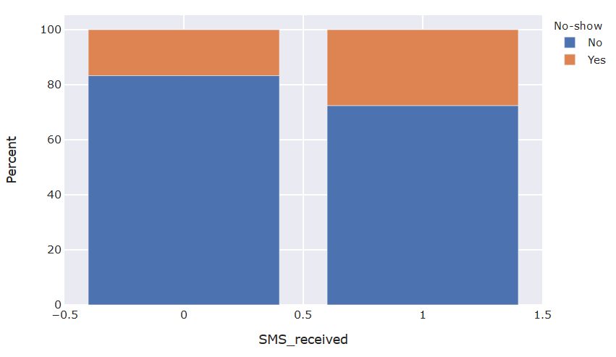
Hospitalization Cancellation
Correlation b/w [SMS and Cancellation status]
People who received SMS are more likely to cancel the appointment

Slide 10
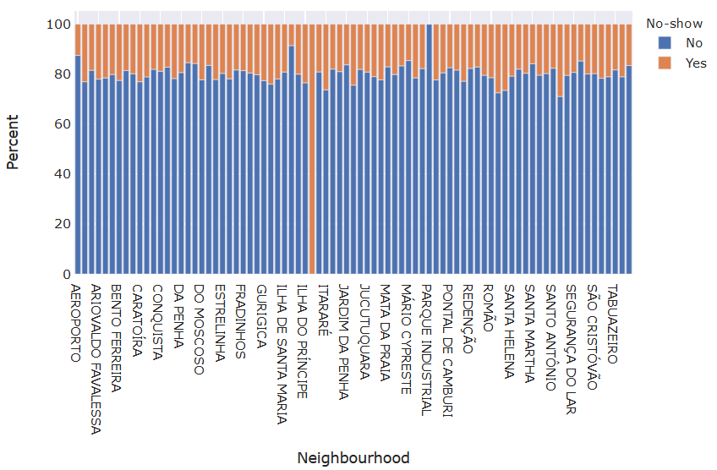
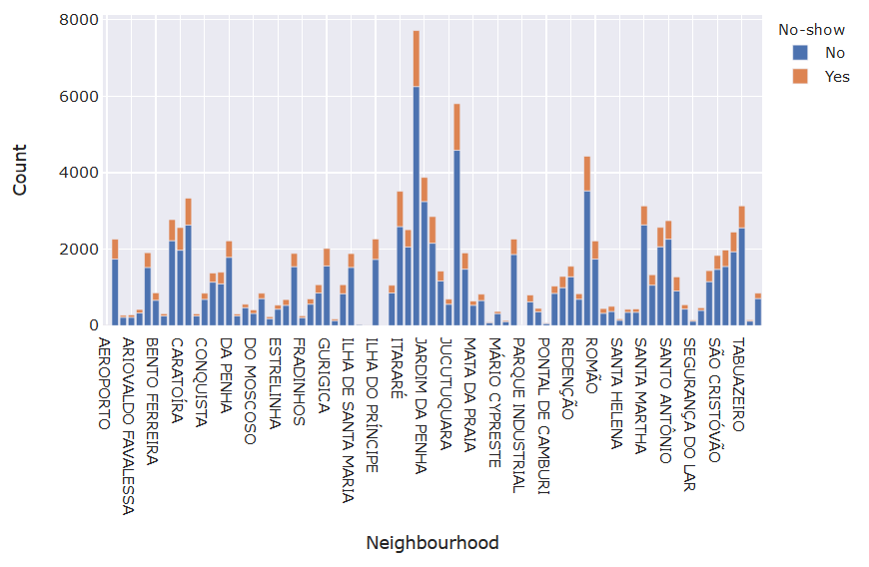
Hospitalization Cancellation
Correlation b/w [Locality and Cancellation status]
No Significant differences across different regions

Slide 11
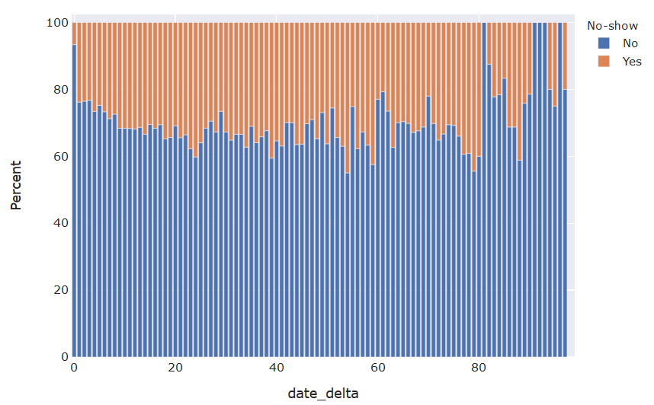
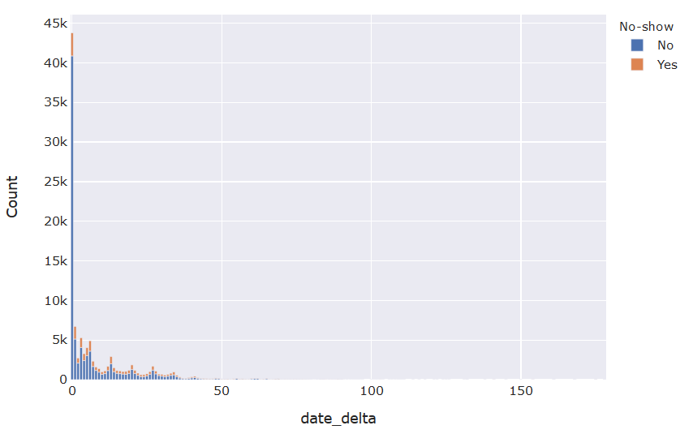
Hospitalization Cancellation
Correlation b/w [Delay - gap b/w schedule and appointment date]
Those who register on the same day, don’t cancel
With Higher date delays the chances of cancellation increases

Slide 12
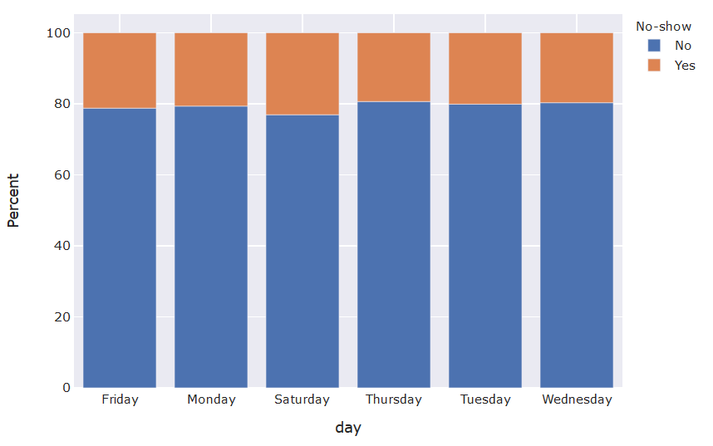
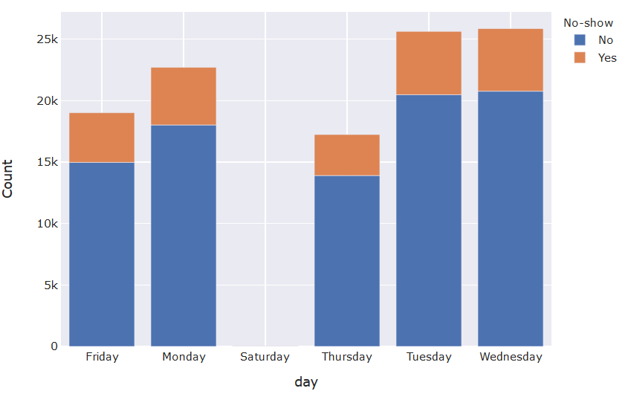
Hospitalization Cancellation
Correlation b/w [Day and Cancellation status]
No particular correlation b/w day of week and cancellations

Slide 13
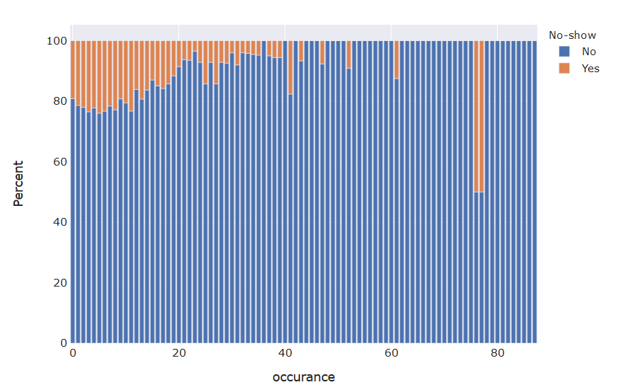
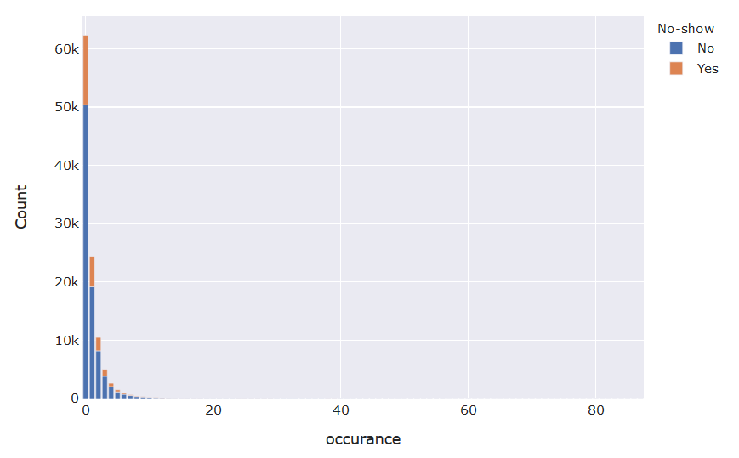
Hospitalization Cancellation
Correlation b/w [Frequent patient and Cancellation status]
People who come more frequently are less likely to cancel the appointment

Slide 14
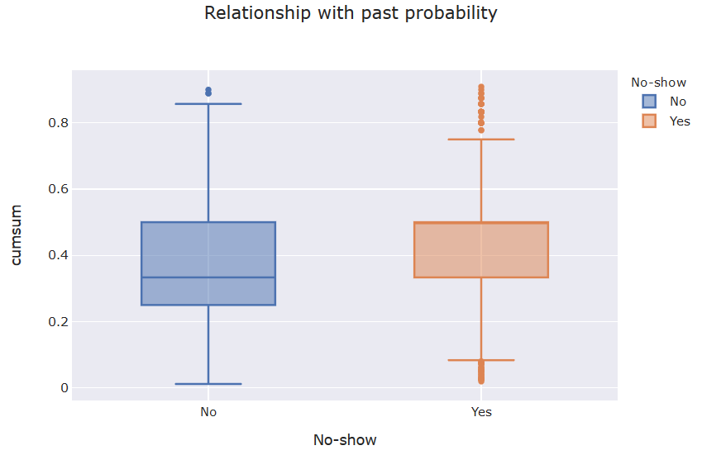
Hospitalization Cancellation
Correlation b/w [Day and Cancellation status]
People who come more frequently are less likely to cancel the appointment

Slide 15
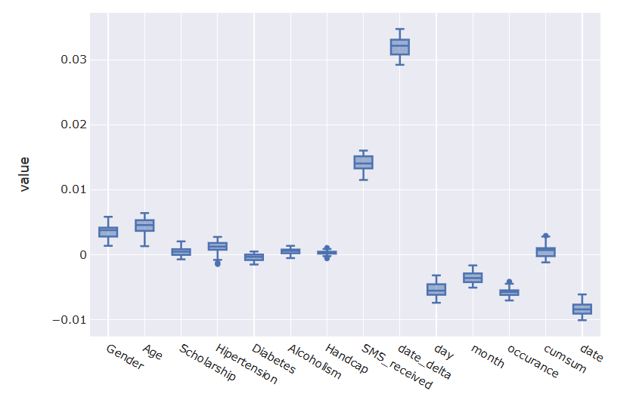
Hospitalization Cancellation
Feature Importance [Permutation Importance]

Slide 16
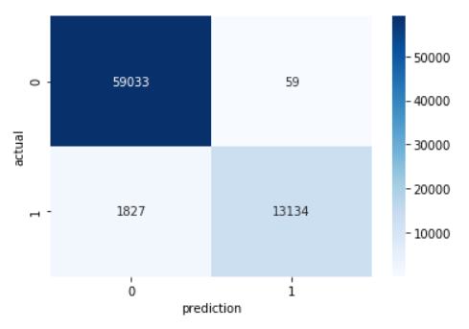
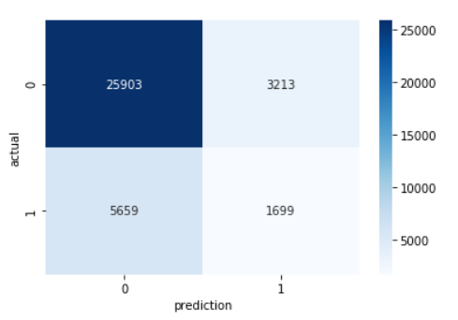
Hospitalization Cancellation
Machine Learning Model [Random Forrest]
Train Precision: 1.0, Test Recall: 0.88
Test Precision: 0.35, Test Recall: 0.23 [Model to be tuned further reducing Model Variance]
Approximately 23% of the Cancellations can be predicted with current model

